Slide 1
Explainable Prediction of Parkinson's Disease from Resting-State Functional MRI Using Hybrid
3D CNN-LSTM Model
Presented by Group 17
Group Members:
22266008 Salman Ibne Eunus
22273013 Asika Islam
23273003 Mitheela Das Armisha
23273004 Sakib Rokoni

Slide 2
Introduction
Parkinson's Disease (PD) is the second most common neurological disorder in the aging population.
It results from decreased dopamine levels in the brain, causing motor issues.
In the initial stage (Phase 0), 90% of patients show vocal cord injury signs.
There's no cure due to the disease's complexity.
Early detection and treatment can ease symptoms, enabling a return to normal life.
Machine learning and deep learning may excel in PD identification.

Slide 3
Literature Review
The most effective classifier for PD detection was a combination of Decision Trees, Regression, DMneural, and Neural Networks (NN), with a maximum accuracy of 92.9%. The NN algorithm contributed to achieving this high accuracy[1]. AI-powered methods have gained popularity in PD diagnosis due to their ability to handle large datasets and achieve substantial reliability without making strict assumptions about data distribution.[1,2]
Long Short-Term Memory (LSTM) method was utilized for identifying Freezing of Gait (FOG), a reliable marker for those with PD who are at risk of falling.[3]
Evidence suggests that, in terms of detecting FOG, LSTM performs better than Support Vector Machines (SVM). In contrast to the usual motor symptoms, this premotor stage is characterized by the occurrence of olfactory loss and Rapid Eye Movement (REM) sleep behavior disorder (RBD) [4].

Slide 4
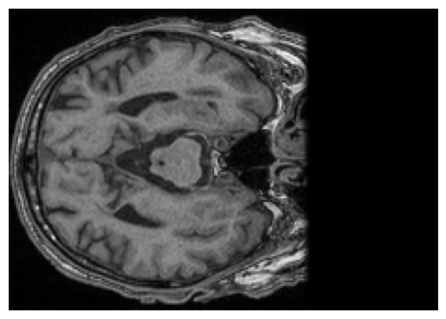
Dataset Collection & Description
In this research work, we are using publicly available Parkinson’s disease datasets from National Institute for Research and Development in Informatics, Romania.
The datasets consists of MRI scan images of parkinson’s disease patients and age-matched healthy controls.
The dataset contains MRI from both anatomical and functional scans.
An Example Image From The Dataset

Slide 5
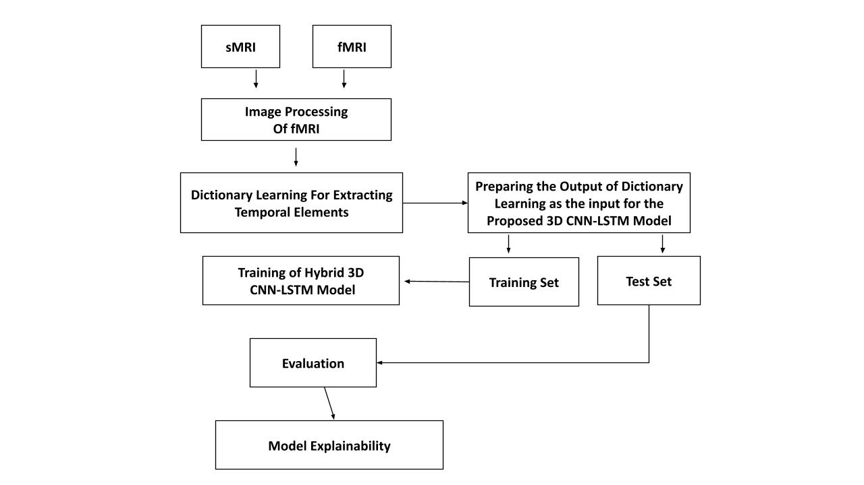
Proposed Methodology
After the dataset is acquired, we plan to apply several steps for the preprocessing of the fMRI images such as - motion correction, gaussian smoothing, etc.
Then we are using dictionary learning based technique which extracts a few representative temporal elements along with sparse spatial loadings, thus giving rise to good extracted maps.
We propose a hybrid three-dimensional model(CNN,LSTM) used. Then the dataset is segmented into training and test set for evaluation.
Finally, we will use model explainability tools like - GRADCAM or LIME to explain what and how the model predicts.

Slide 6
References
[1] R. Das, “A comparison of multiple classification methods for diagnosis of parkinson disease,” Expert Systems with Applications, vol. 37, no. 2, pp. 1568–1572, 2010.
[2] A. S. Ashour, A. El-Attar, N. Dey, H. A. El-Kader, and M. M. A. El-Naby, “Long short term memory based patient-dependent model for fog detection in parkinson’s disease,” Pattern Recognition Letters, vol. 131, pp. 23–29, 2020.
[3} H. Gunduz, “Deep learning-based parkinson’s disease classification using vocal feature sets,” IEEE Access, vol. 7, pp. 115 540–115 551, 2019
[4] [17] S. Sharma, C. S. Moon, A. Khogali, A. Haidous, A. Chabenne, C. Ojo, M. Jelebinkov, Y. Kurdi, and M. Ebadi, “Biomarkers in parkinson’s disease (recent update),” Neurochemistry international, vol. 63, no. 3, pp. 201– 229, 2013.

